Slide 1
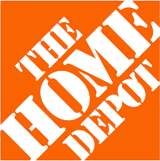
The Home Depot
Intro to Data Management Project
By Bhavna Kaparaju, Brett Nesfeder,
Callie Gilmore & Dawson Cook

Slide 2
The Home Depot
The Home Depot is the largest home improvement retailer in America
They supply tools, construction products, and home improvement services.
Founded in 1978 in Atlanta, Georgia
Currently has 2,278 stores across North America
WIth a large amount of stores and locations, The Home Depot deals with a huge amount of data on a daily basis.

Slide 3
Data Strategy
Offensive Strategy
Highly Competitive Market (Lowe’s, Walmart, Amazon)
Focus on supporting revenue growth
Generate customer insights
Integrate customer and market data to support managerial decision making

Slide 4
Steps
Transactional Applications - ERDs and DDL
ETL Process
Analytical Patterns and Processes
Data Warehouse - ERD and DDL
Data Lake

Slide 5
Transactional Applications

Slide 6
3 Transactional Applications
Customer POS
Inventory
Wholesale Purchasing
Point of sale system to track customer purchases
Inventory system to keep track of stock and determine when to re-purchase
Wholesale purchasing to re-new stock when necessary

Slide 7
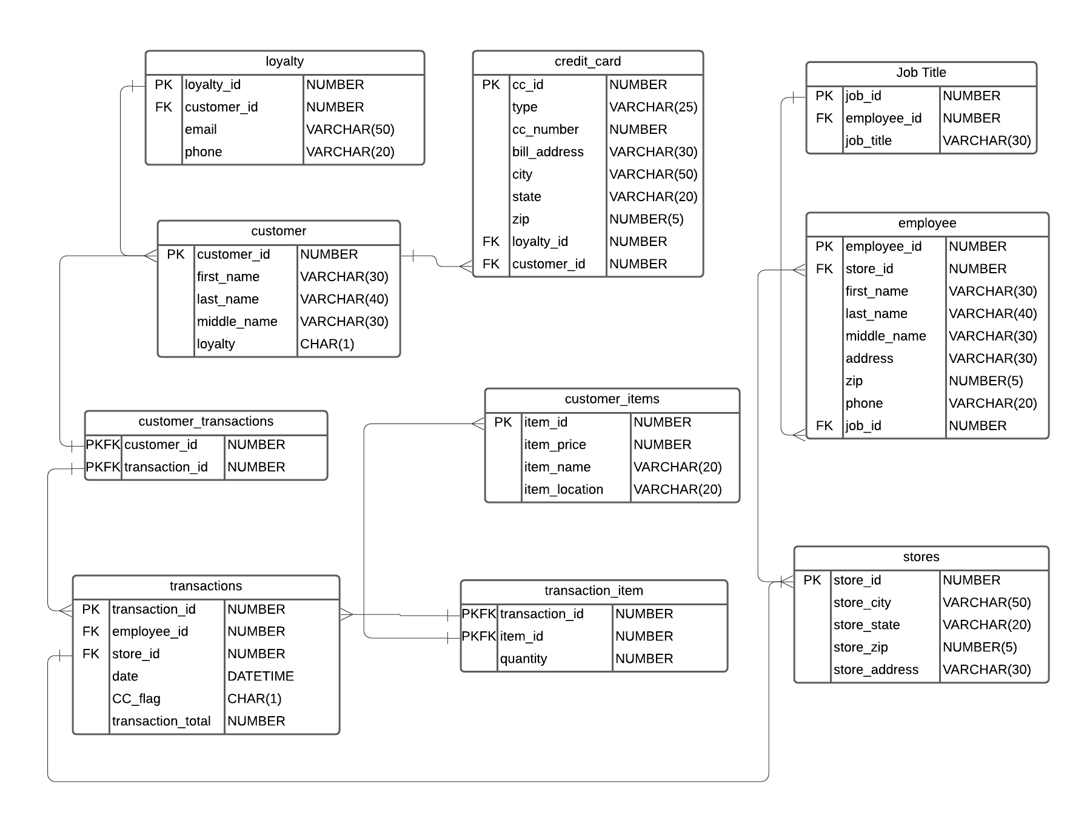
Customer POS ERD

Slide 8




Customer DDL & Inserts

Slide 9
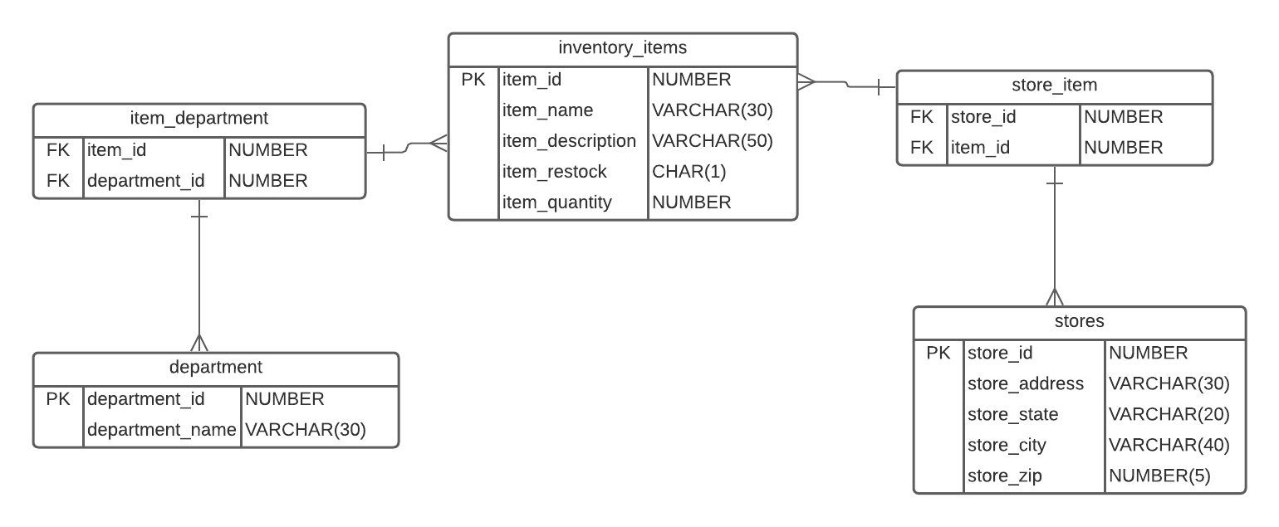
Inventory ERD

Slide 10



Inventory DDL & Inserts

Slide 11
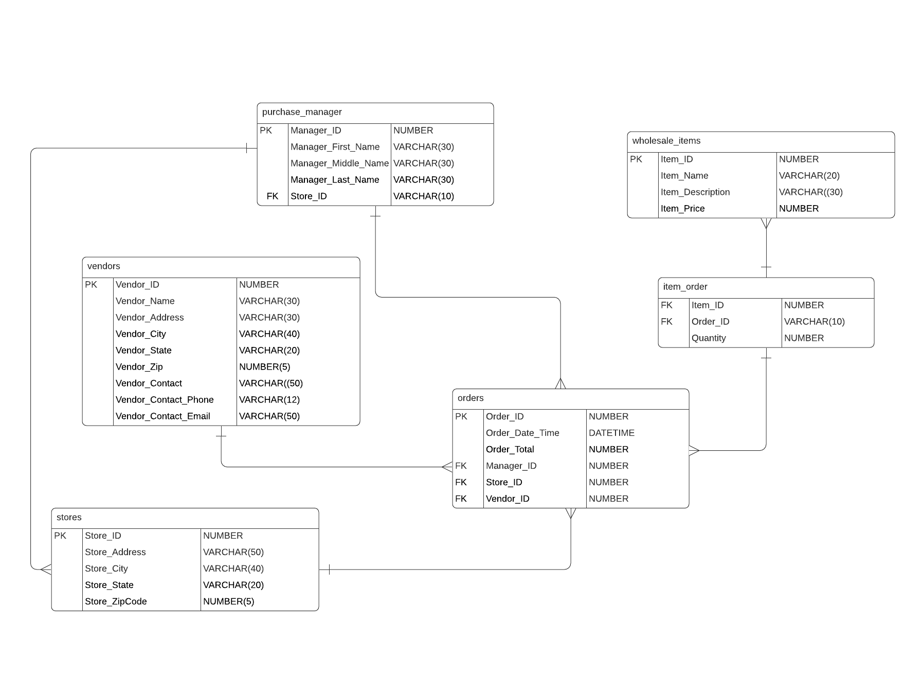
Wholesale Purchasing ERD

Slide 12

Wholesale Purchasing DDL & Inserts

Slide 13
Data Warehouse
Notes:
Dawson

Slide 14
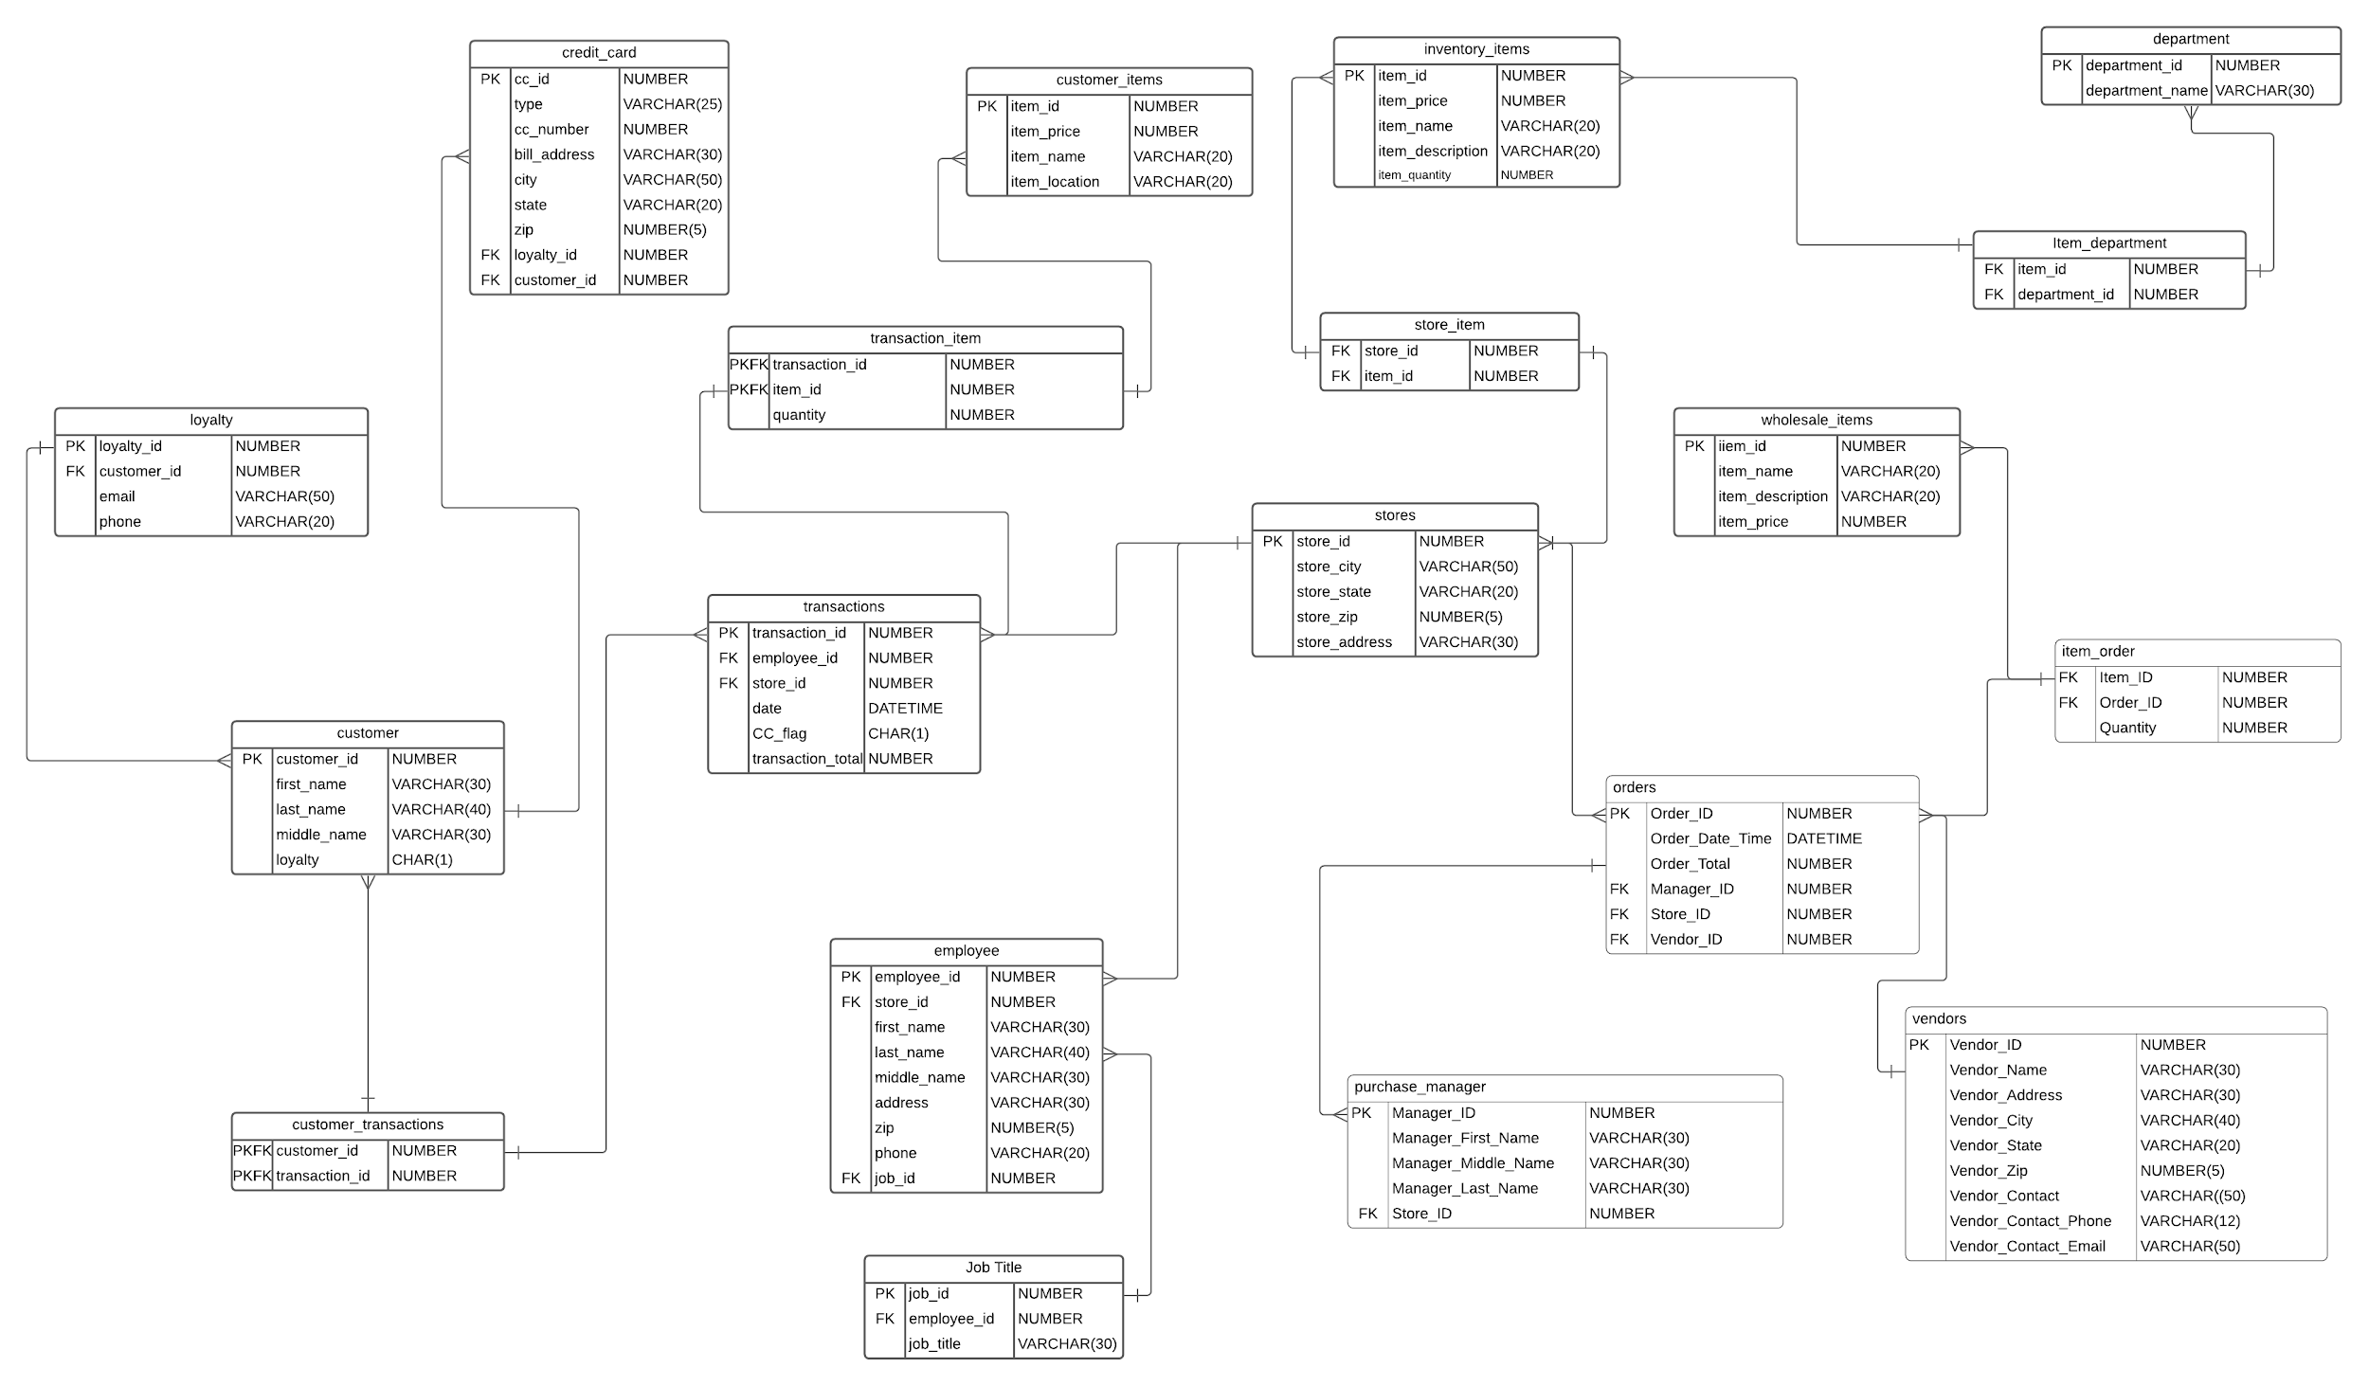
Data Warehouse ERD
Notes:
Dawson

Slide 15
ETL Process
Notes:
Dawson

Slide 16
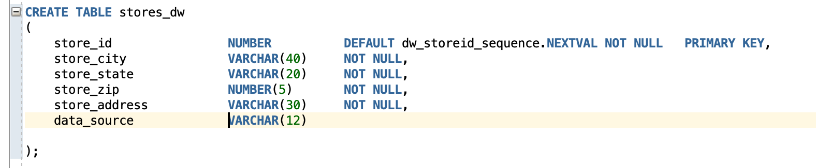
ETL - Store Example
Notes:
Dawson

Slide 17
Data Lake
Notes:
Dawson

Slide 18
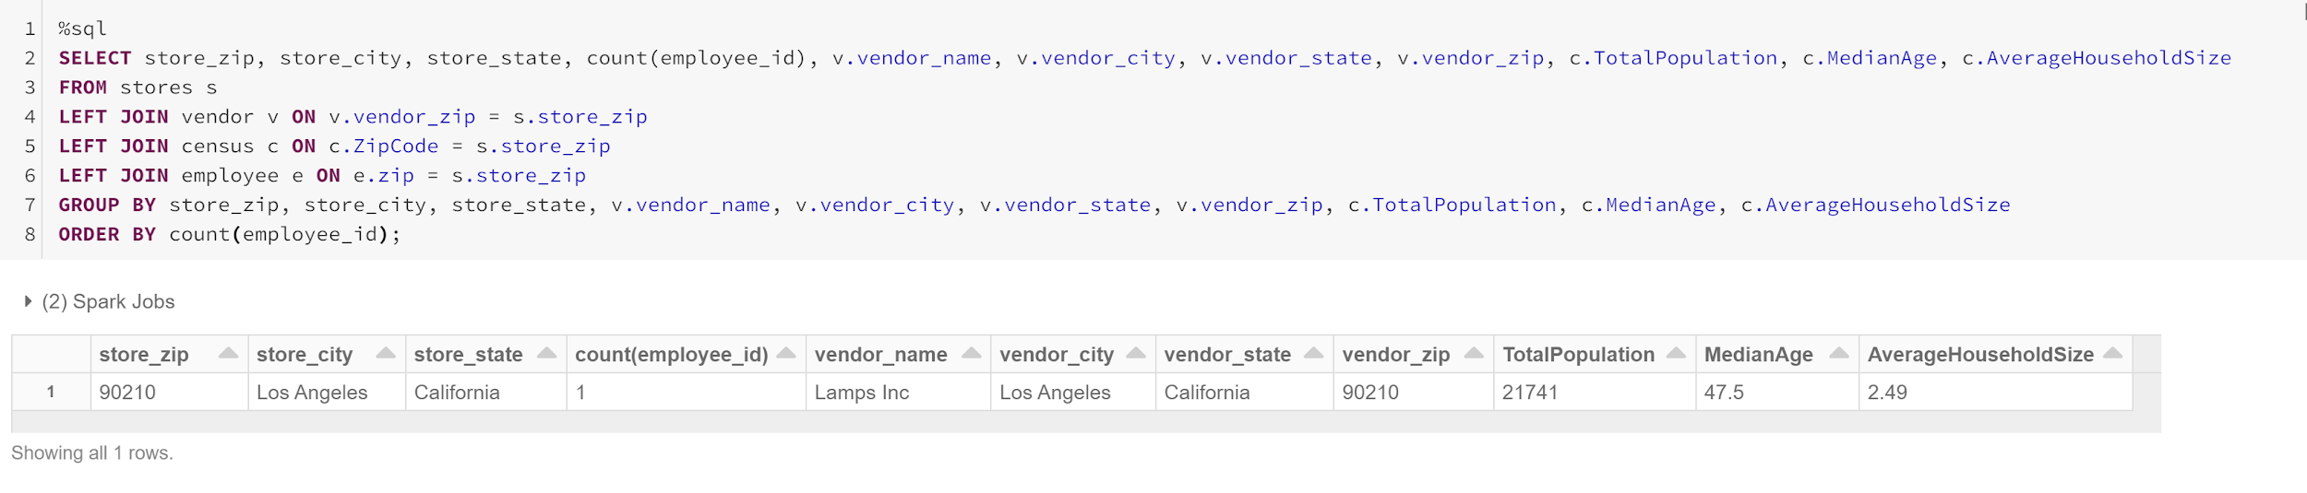
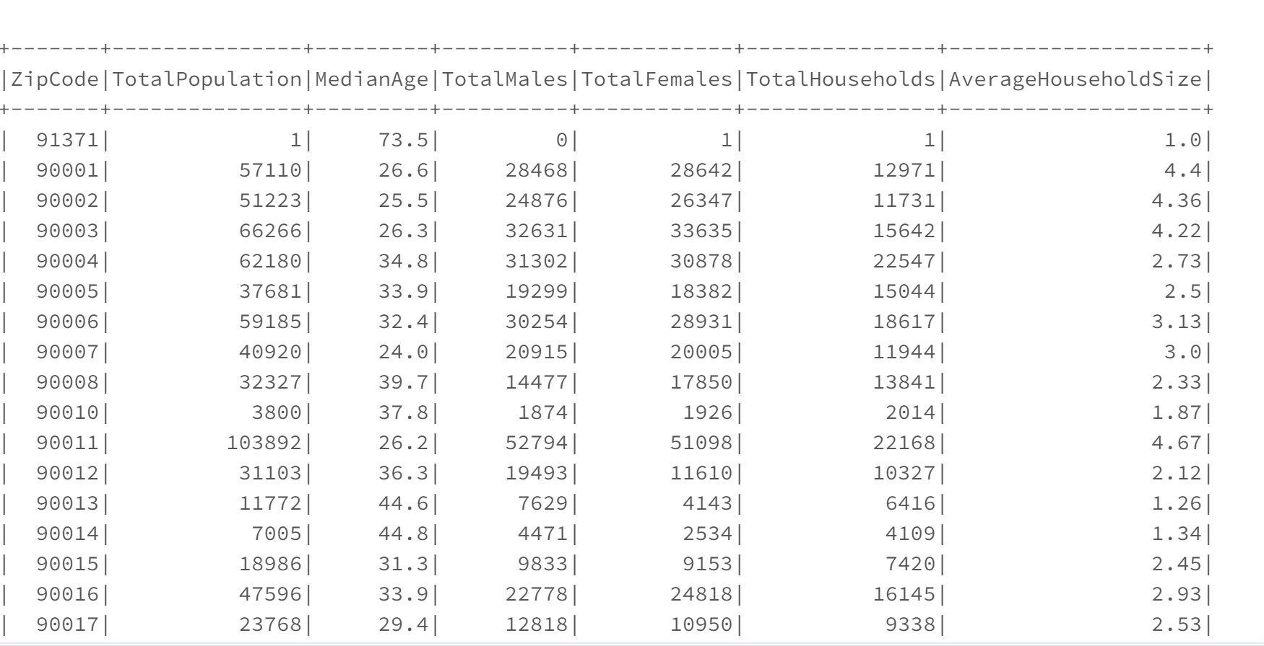
Data Lake
Notes:
Dawson
For our data lake, we decided to utilize the store data, employee data and vendor data that we created for our transactional process applications and utilized in our data warehouse through the ETL Process. We decided on this data because we thought it would be interesting to understand store, employee and vendor data by zip code and then compare that to zip code demographic data. Additionally, we found Census data that contained the Zip Code, Total Population, Median Age, Total Males, Total Females, Total Households and Average Household Size. We thought this demographic data would be interesting for home depot in relation to store data, vendor data and employee data. Below, you can see the census data that we utilized and the data lake we created where joined the census data with our data. With more data from Home Depot, this data lake would be very interesting to run analytics on store, employee and vendor data as it relates to store demographics. Additionally, we ran some aggregations to understand the data better. For example we ran a count function on employees, vendors and stores so that we could compare the number of stores, vendors and employees with the demographic data.

Slide 19
Analytical Patterns

Slide 20
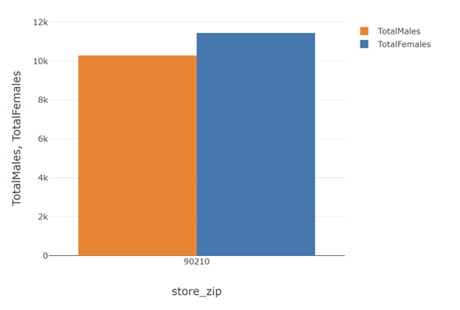
Total Males vs Total Females by Zip Code

Slide 21
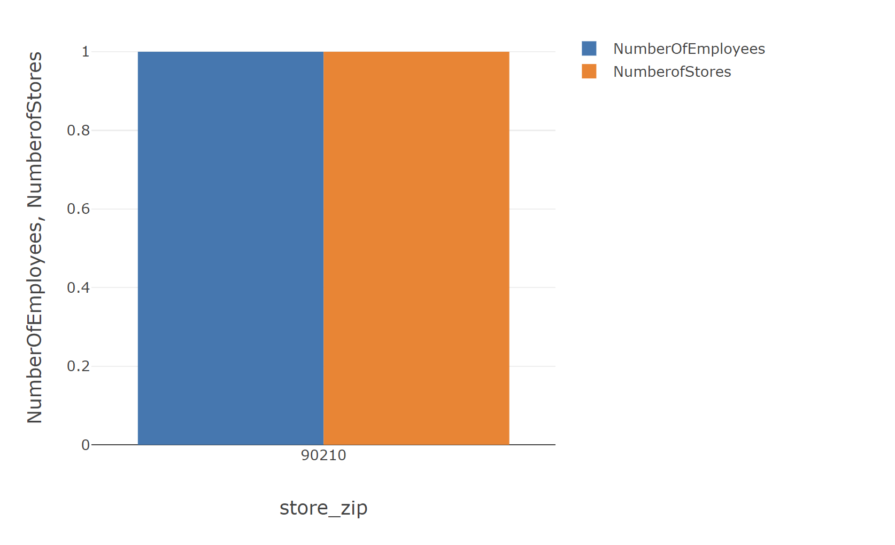
Total Employee Count vs Total Number of Stores

Slide 22
Conclusion

Slide 23
Final Thoughts
Corporate Data Environments are very complex
Clear & organized naming conventions are required to keep everything straight
Clear & concise documentation on what you did and how you did it will not only help yourself but will also help team members and overall organization
Value: Data only matters if you can access it. This project taught us the importance of maintaining complex data environments so that we can access it and perform analytics.
Going forward: practicing documentation, organization and clear naming conventions

Slide 24
Thanks!
Any Questions?

